Slide 1
Basketball Tracking with Deep Learning
By Trae Primm

Slide 2
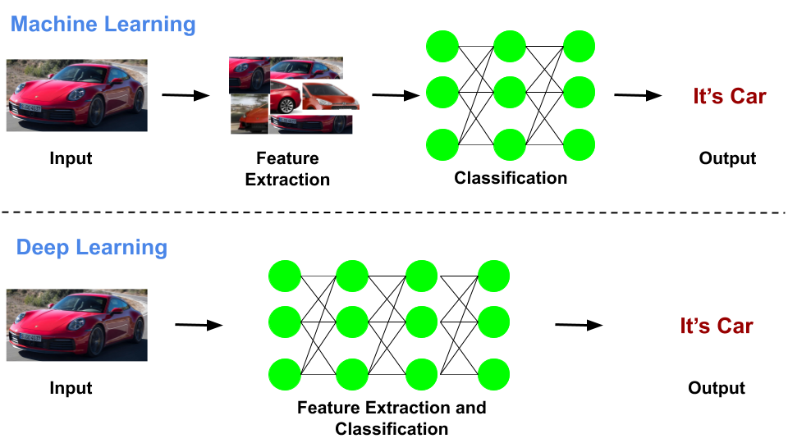
What is Deep Learning?
Deep learning is a newer subfield of Machine learning that uses neural networks and has greater success in areas such as images, videos, and audio processing

Slide 3
Three types of Machine Learning
When talking about types of models there are generally three different types.
Supervised: Labeled datasets(I.E. image recognition, predict numbers, ect…)
Unsupervised: Unlabeled datasets(I.E. generating images, clustering, ect…)
Reinforcement: Think of training a dog if it does the right thing reward it if it does the wrong thing punish it
I am using Supervised learning for my project.

Slide 4
Onto my project
I would say one of the most challenging things in machine learning or deep learning is understand what type of model you want to use and how to set up a dataset for said model.
I ended up with the YOLOv4 model architecture for my project.

Slide 5
The Hard Part
I would say the hardest part is collecting your data and forming it to the model. In my case I recorded several hours of video footage. Unfortunately all of the original data could not be used because it was to low resolution so I had to do it again.
For the videos I recorded at The Fit and setup my camera on the railing of the indoor track to look at one of the basketball goals below.

Slide 6
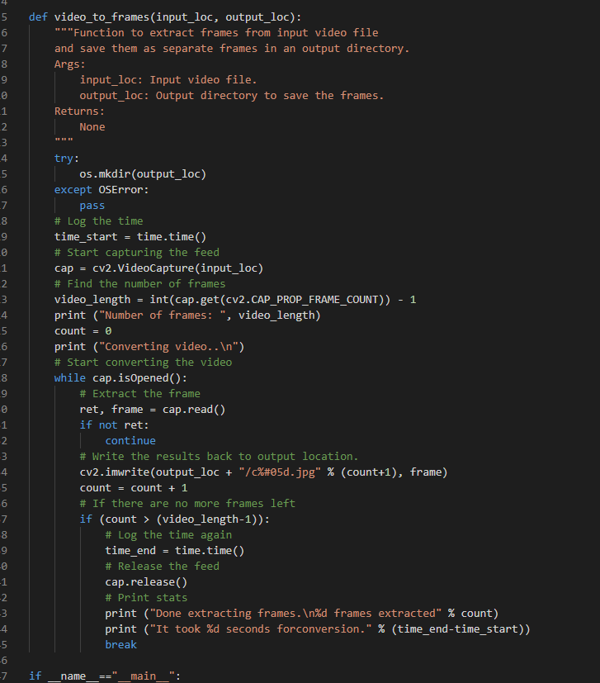
Vids_to_frames.py
This is the main function for the script that takes an input video and outputs frames to a directory.

Slide 7
Boxes
Yolo uses a bounding box method for classification. It needs the image and it also needs a txt file consisting of the box description.
The format should be: <object-class> <x> <y> <width> <height>
Thanks to tzutalin he uploaded a tool called labelimg to make the correct files for us.

Slide 8
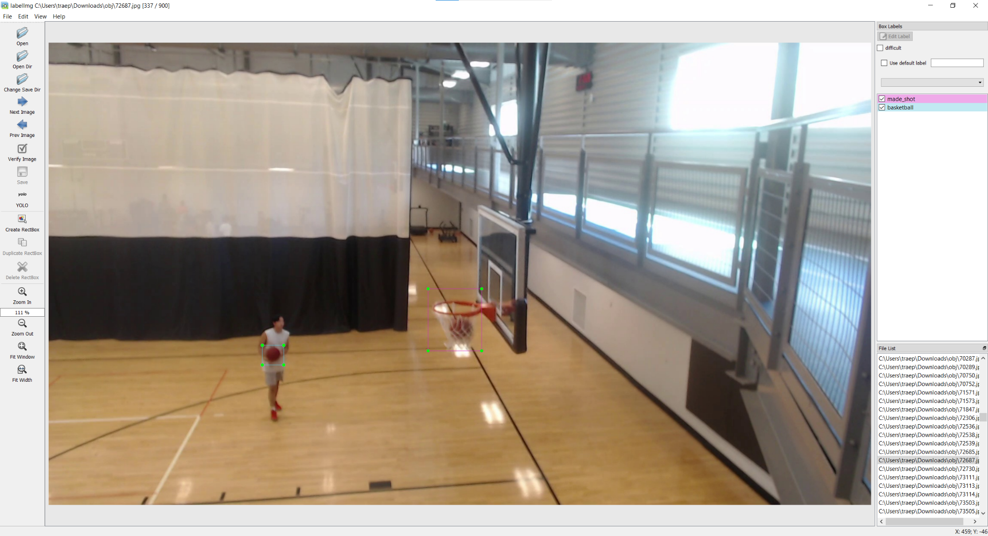

Slide 9
Training Montage
I had difficulties getting the model to run on a windows machine so I set up a google colab which is linux to handle the model. Any time a code segment starts with a ! or % means it is a console command.
After setting up the correct configs and data structure I run this command:
!./darknet detector <function> <.data> <.cfg> <weights> -dont_show -map
For me it looks like:
!./darknet detector train data/obj.data cfg/yolov4-basketball.cfg yolov4.conv.137 -dont_show -map

Slide 10
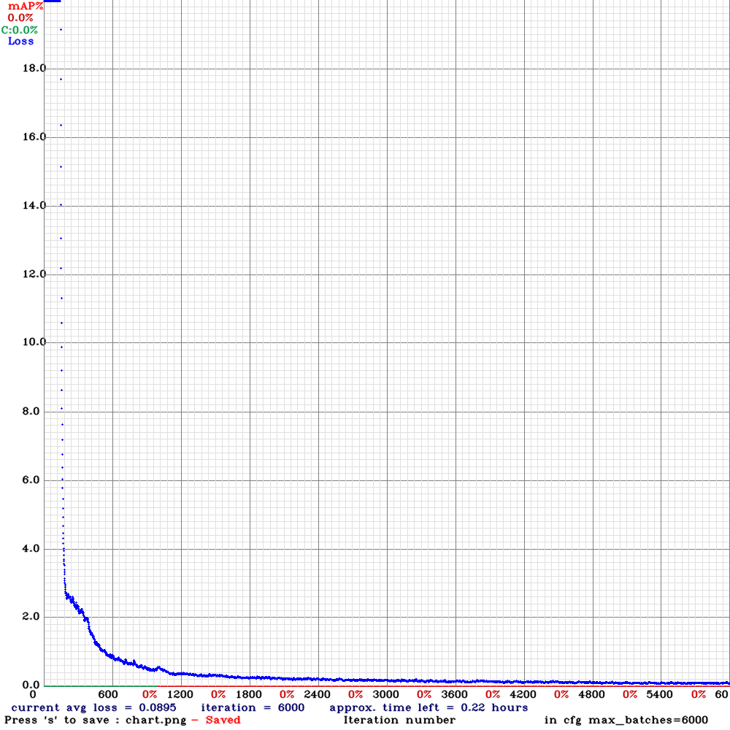
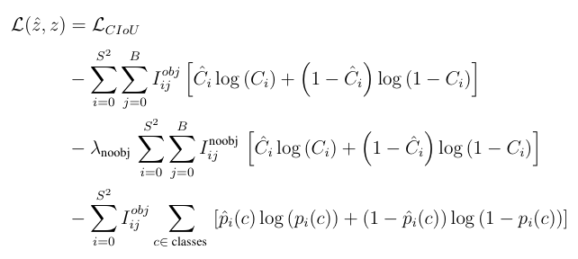
Results
The blue dots show the loss function of each iteration.
The loss function for YOLOv4 can be shown as:
Notes:
To keep it short it uses a Distance-Intersection over Union(IoU) loss. This incorporates the normalized distance between the predicted box and the target box.This loss function helps insure that these predicted boxes are moving in the right direction.

Slide 11
Testing time
YOLO has another function built in called test and demo. I will use both of them to get results to process.
The first is demo to get a visual demo of a test clip.
The second is test to get a file generated with what the computer did.
Both of these commands look similar just using their respected names instead of train.

Slide 12
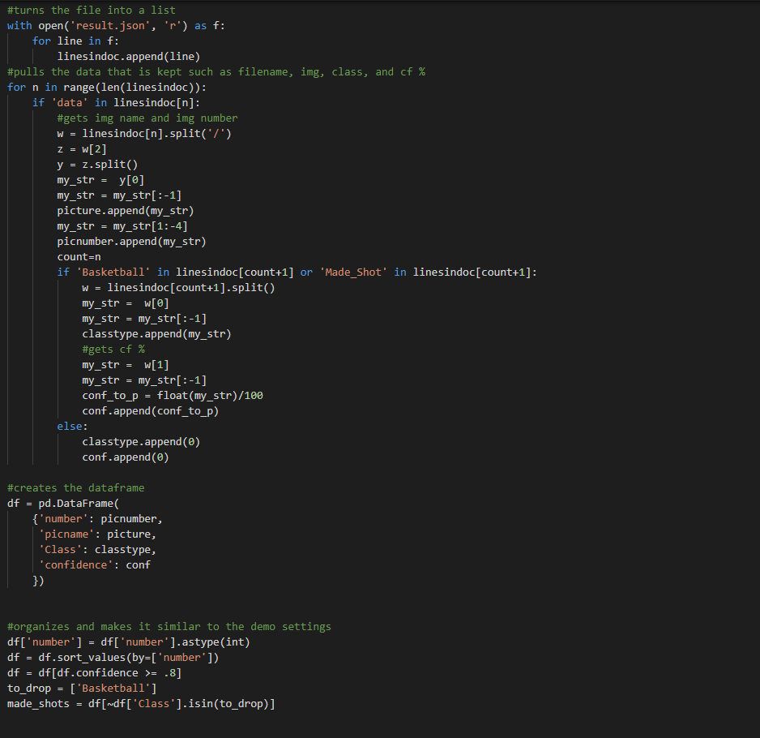
Results
After running the test function I created a script to process the output file and after running that file it showed that there was some false positives.
To the right is a section of the proccess_results.py script.

Slide 13
Fin

